Slide 1

Manufacturing Practice Lab
Mallikarjuna B
Assistant Professor
Mechanical Engineering
Coimbatore
E-mail ID: b_mallikarjuna@cb.amrita.edu
Mobile no: +91 8310405141

Slide 2
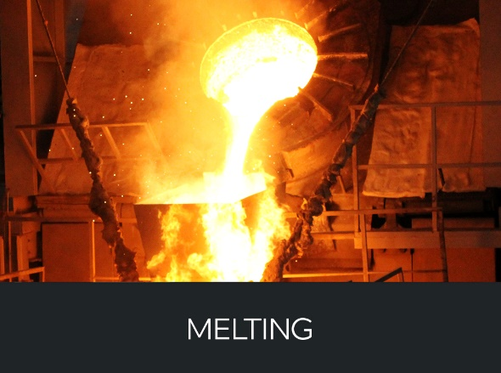
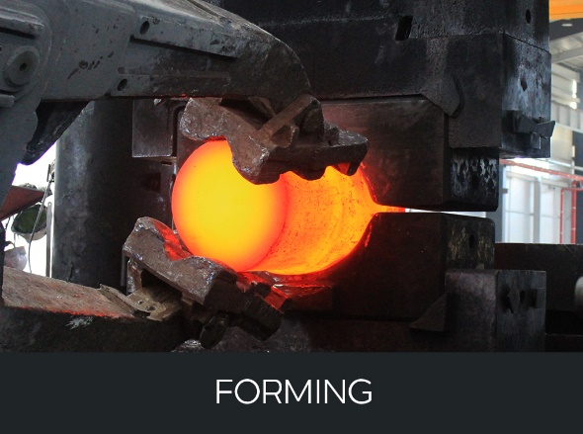
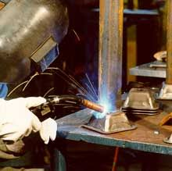
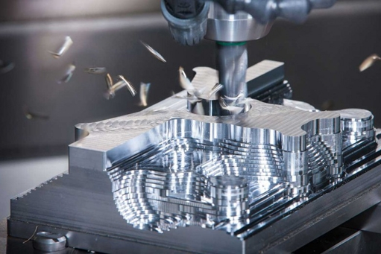
Manufacturing Methods
JOINING
Predominantly dominated by subtractive process
SUBTRACTIVE
Internet source: http://hvm.co.kr/e_process/e_forming/

Slide 3
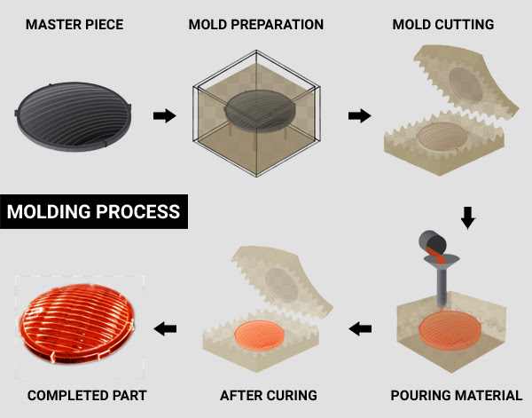
How Do We Make Components Conventionally?
Courtesy: Think3D

Slide 4
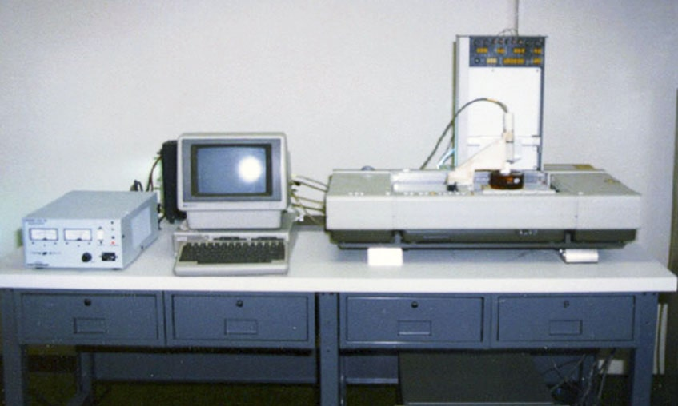
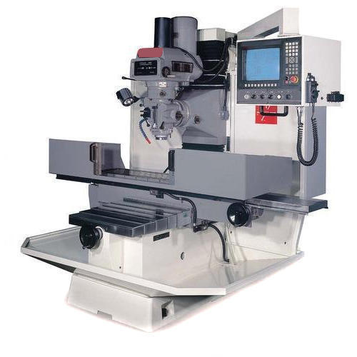
Paradigm Shift to the Technology
The subtractive dominated till the 1987
Not only in the machining processes also forging, casting, joining processes
CNC machine
SLA machine
Credit link: https://www.indiamart.com/proddetail/cnc-milling-machine-14874331991.html
Credit link: https://www.sculpteo.com/en/3d-learning-hub/basics-of-3d-printing/the-history-of-3d-printing/

Slide 5
History of AM
In 60s Herbert Voelcker thoughts of the possibilities of using computer aided machine control to run machines that build parts from CAD geometry
During 70s, he developed the mathematics to describe 3D aspects that resulted in the first algorithm for solid modeling
In 80s, Carl Deckard came up with the idea of layer based manufacturing
Charles Hull took the credit for development of a additive manufacturing system (Stereolithography) during 1986

Slide 6
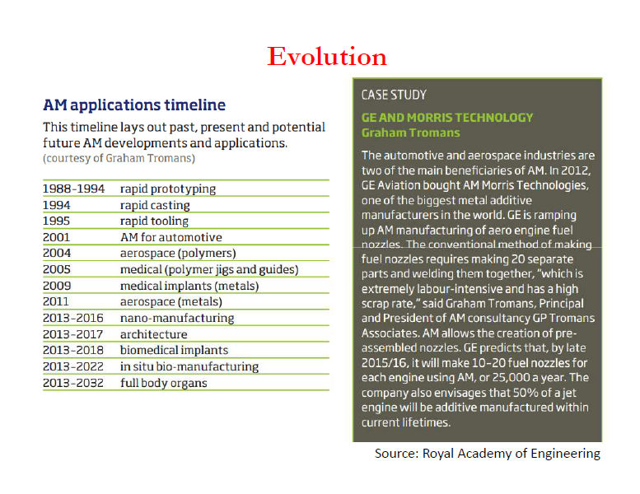
Evolution of Additive Manufacturing

Slide 7
Introduction to Additive Manufacturing
What is Additive Manufacturing?
Additive Manufacturing (AM) refers to a process by which digital 3D design data is used to build up a component in layers by depositing material.
(ASTM F42 Committee 2009)
Many names includes layer manufacturing, freeform fabrication, fused deposition modeling, laser beam melting, rapid prototyping, rapid manufacturing etc.
Additive Manufacturing commonly referred as 3D Printing

Slide 8

Additive Manufacturing Movie Clip

Slide 9
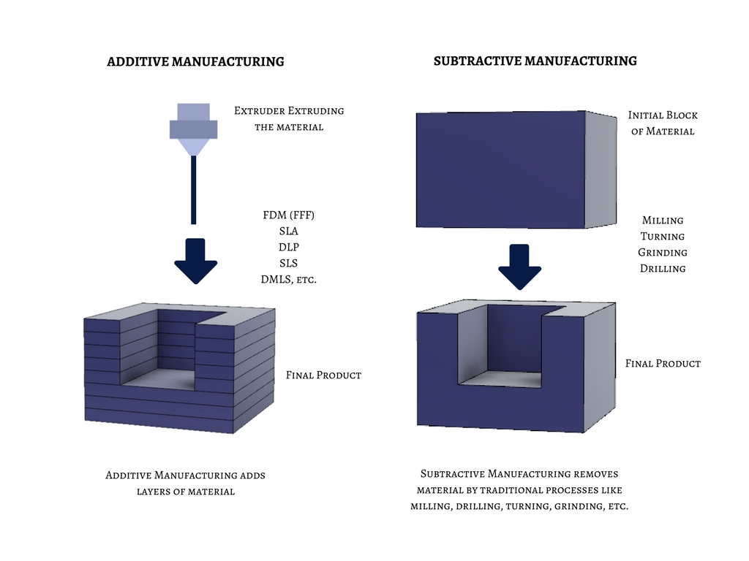
Additive and Subtractive Manufacturing

Slide 10
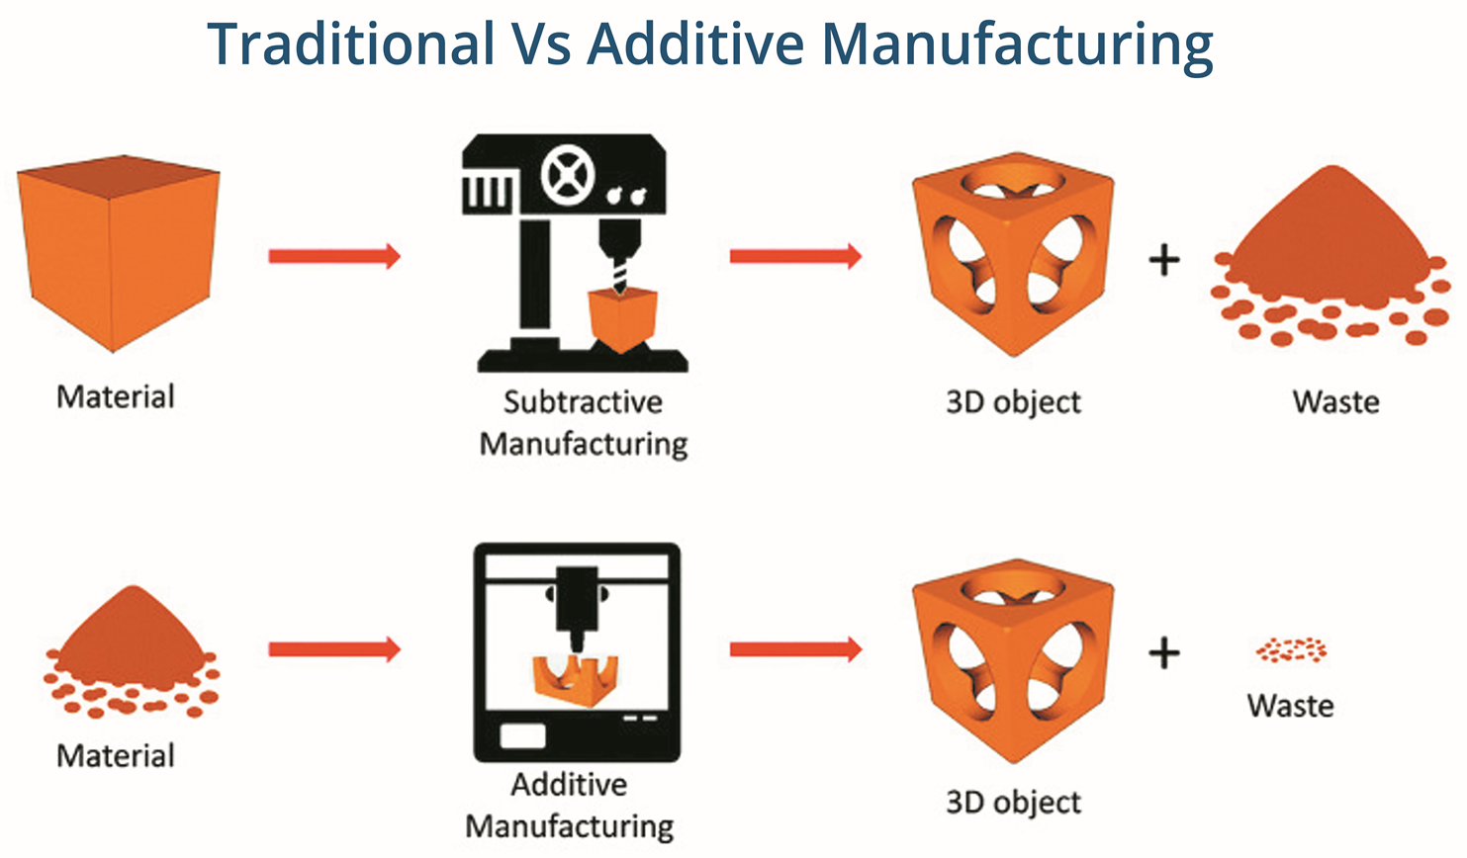
Traditional Vs Additive Manufacturing

Slide 11
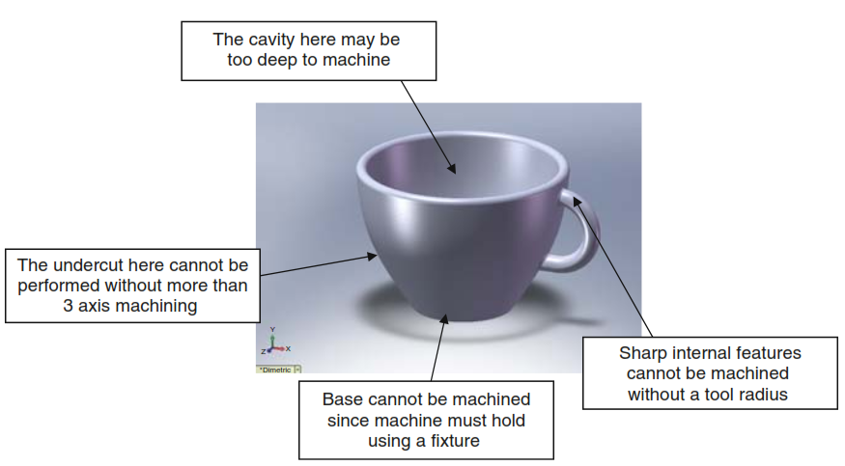
CNC Machining Vs Additive Manufacturing
Features that represent problems using CNC machining (Credit: Additive manufacturing technologies by Ion Gibson)

Slide 12
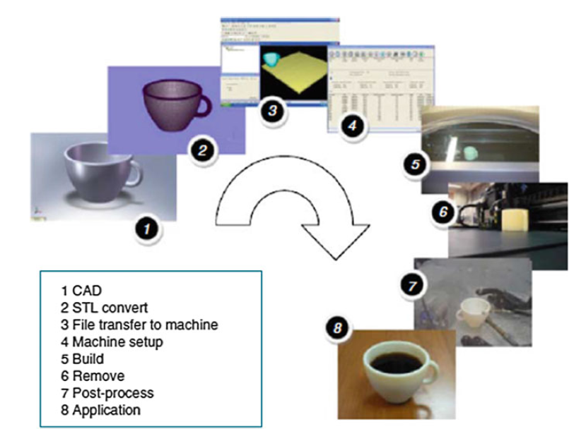
Generic AM Process
(Source: Ian Gibson, David W Rosen, Brent Stucker., “Additive Manufacturing Technologies: Rapid Prototyping to Direct Digital Manufacturing”, Springer, 2010)

Slide 13

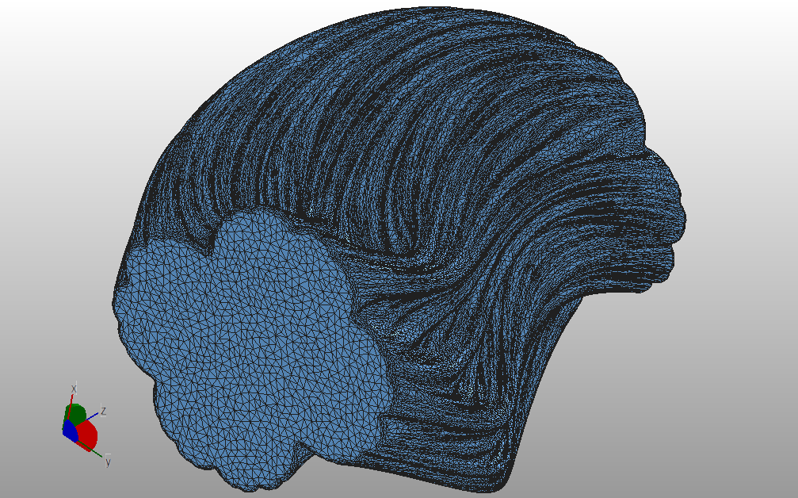
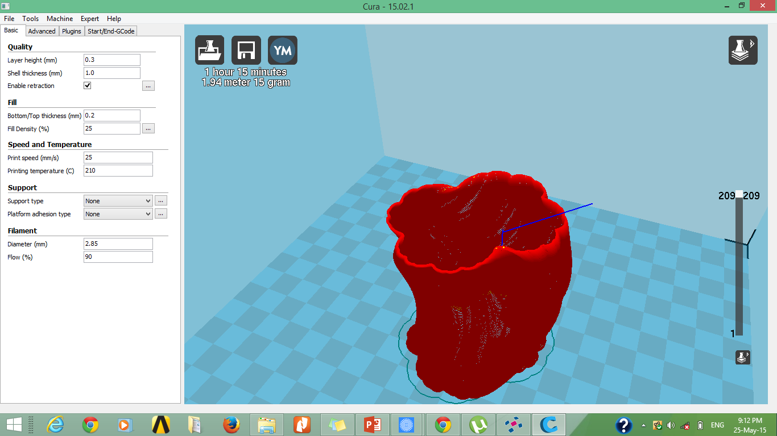
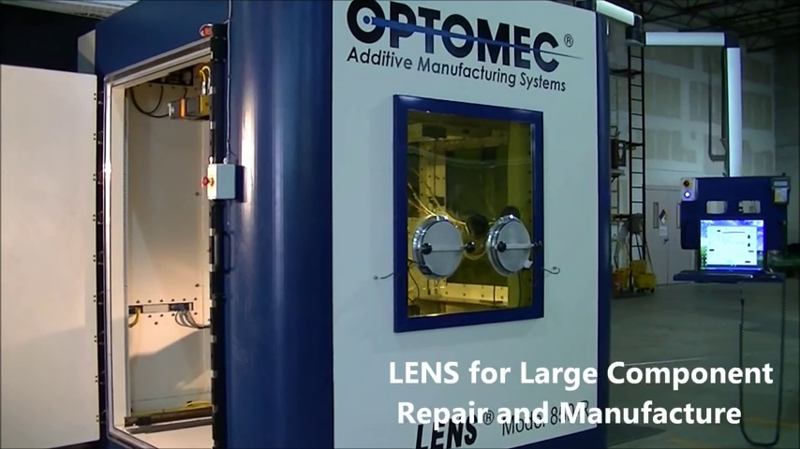
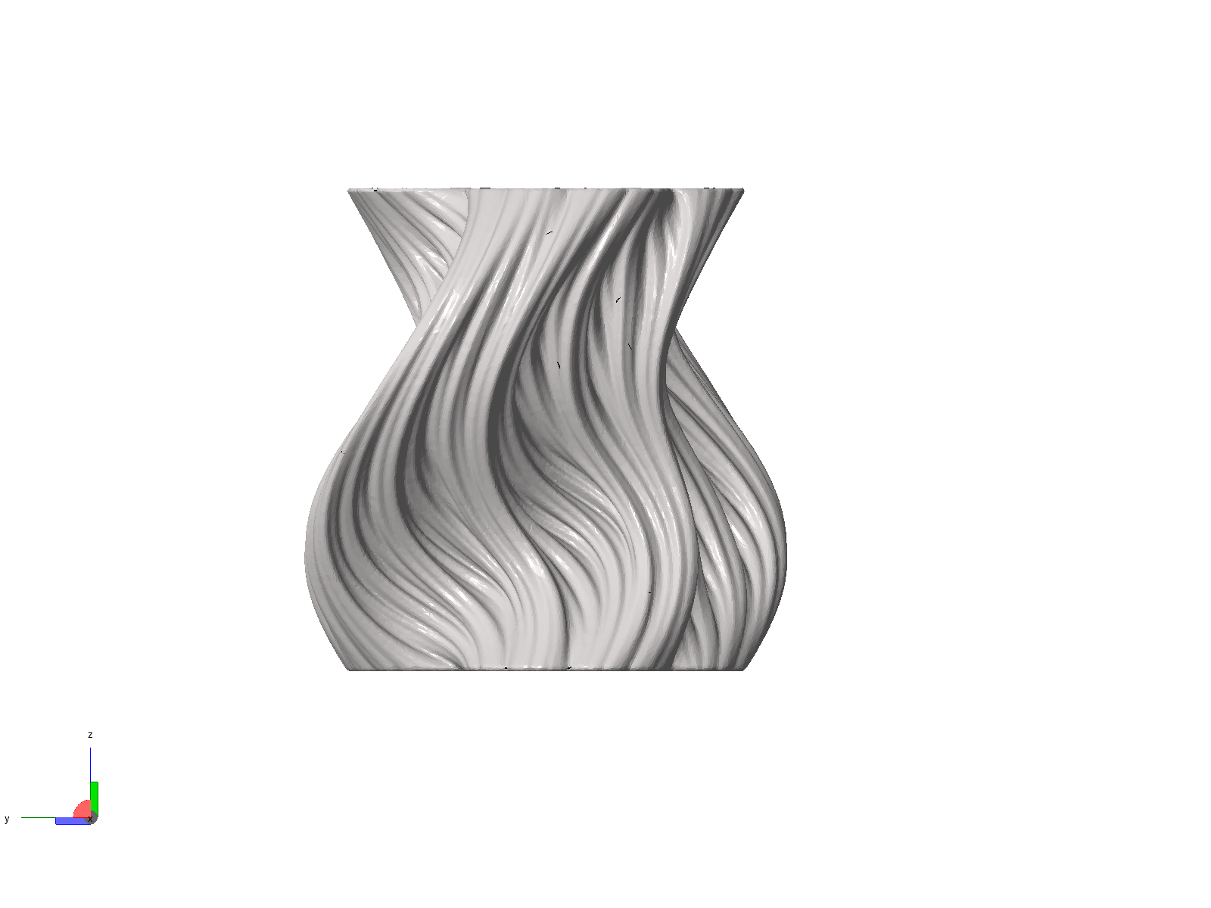
1
2
3
4
CAD
STL file conversion
Slicing
Machine Loading G-code
5
6
7
GENERIC Process Steps of Part Building in AM
Building
Post processing
Final Part

Slide 14
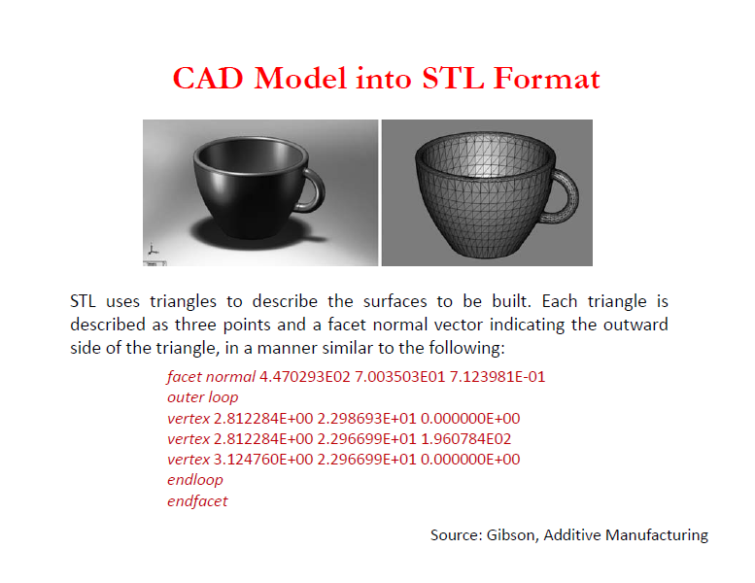
CAD to STL File

Slide 15
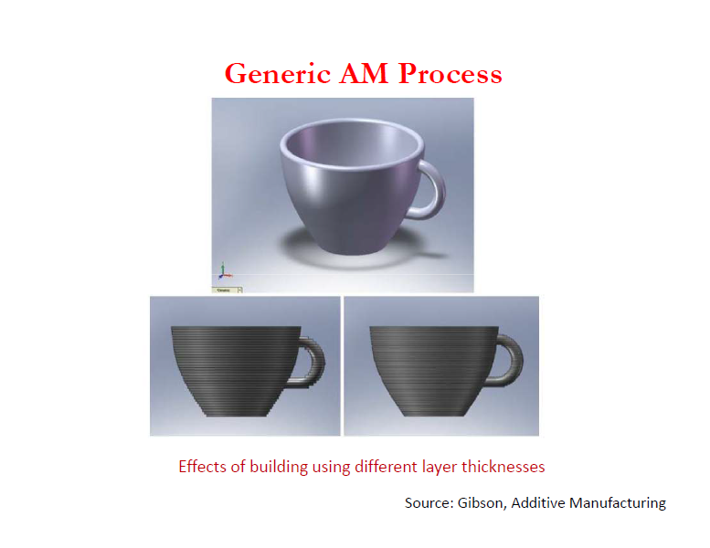
Effect of Layer Height

Slide 16
Classifications of AM Processes
AM Processes
Material State
Solid
Powder
Liquid

Slide 17
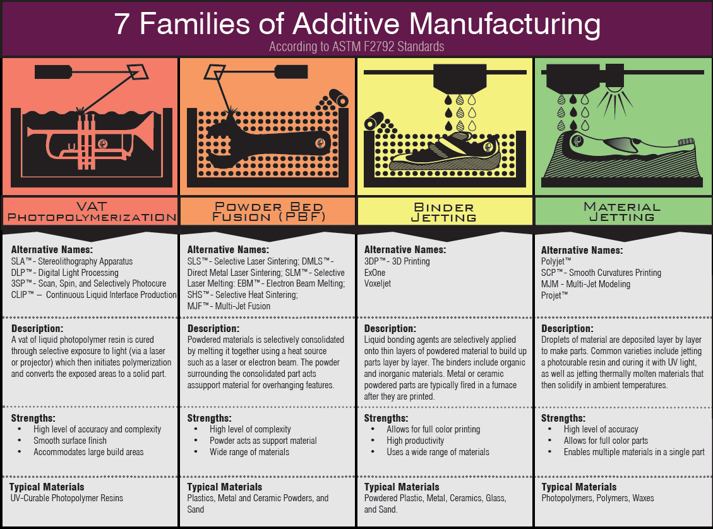
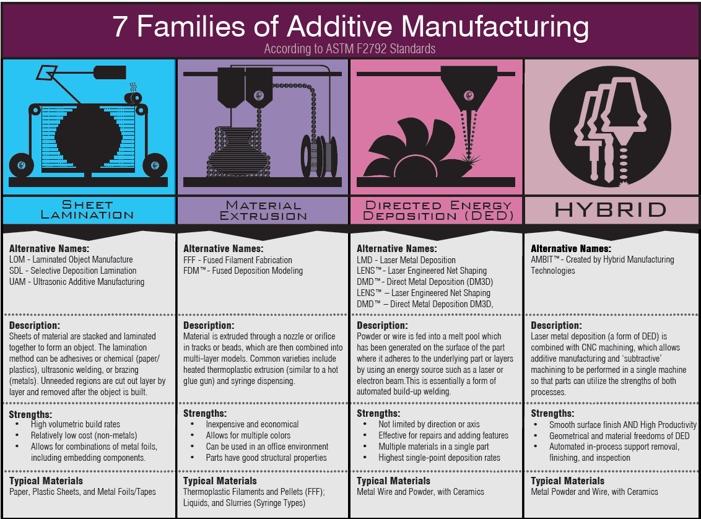
Types of AM Processes
Some New Technologies 1. Meld manufacturing 2. 3DMP
https://www.gefertec.de/en/3dmp-process/
(Source: Hybrid Manufacturing Technologies)

Slide 18
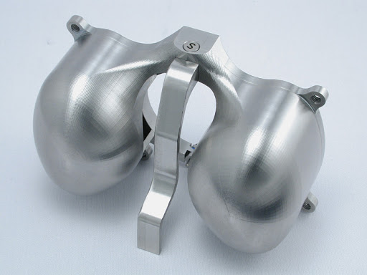
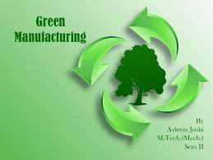
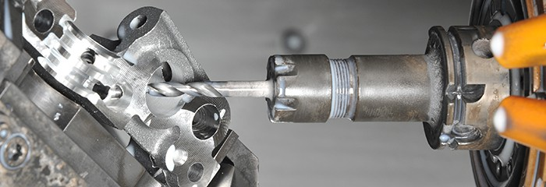
Advantages of AM Processes
Complex geometry with no additional costs
Reduction of manufacturing lead time
No expensive tooling required
Dimensional accuracy
Wide range of materials (polymer, ceramic, metal,..)
Green manufacturing
Complex parts
Green manufacturing
No tooling

Slide 19
Limitations of AM Porcesses
Part size
Most suitable for mass customization rather than mass production
Materials: Non weldable materials are difficult to process by AM
Properties: Could achieve 99.9% density with some residual porosities
Inferior than cast/wrought metals

Slide 20
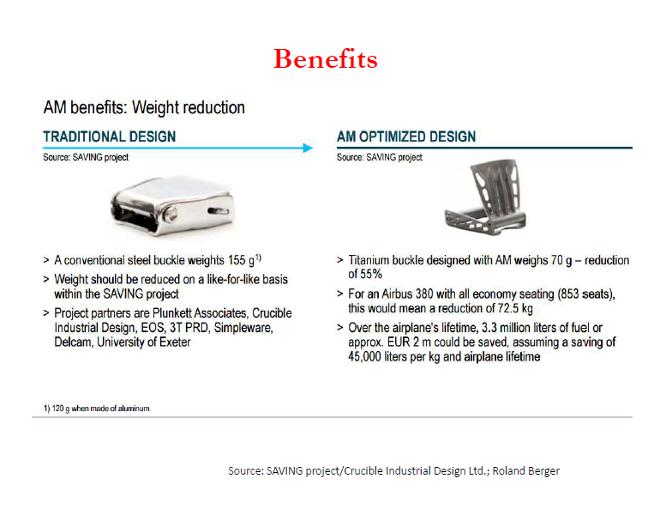
Case Studies of AM

Slide 21
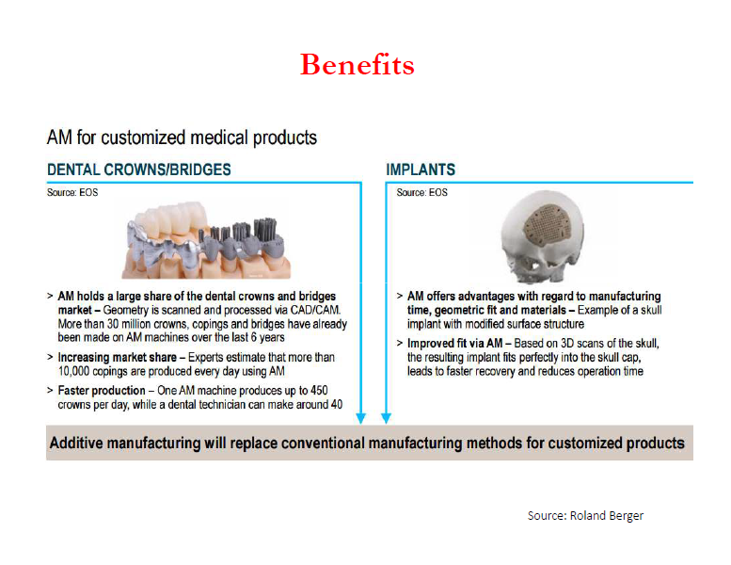
Case Studies of AM

Slide 22
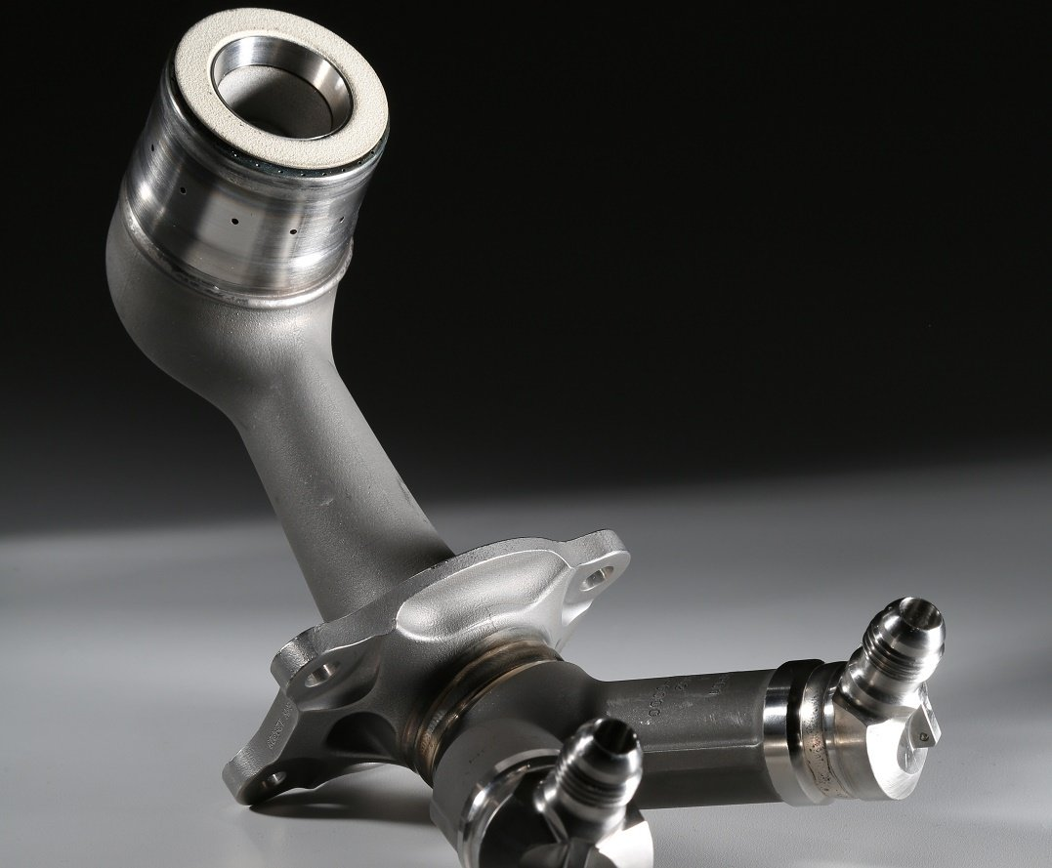
Case Studies of AM
Under the additive manufacturing method, the number of parts in a single fuel nozzle tip was reduced from about 20 pieces previously welded together to one whole piece.
The nozzle tip’s weight was cut by about 25 percent.
Fuel Nozzle Tip for LEAP Engine
Credit link: https://www.ge.com/additive/stories/new-manufacturing-milestone-30000-additive-fuel-nozzles

Slide 23
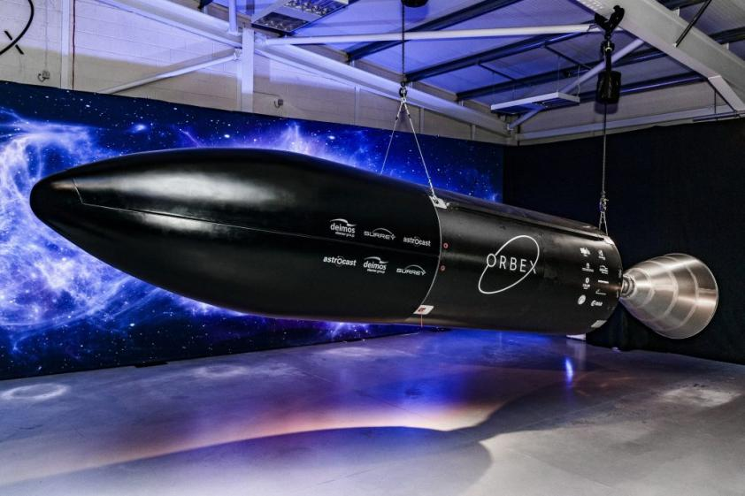
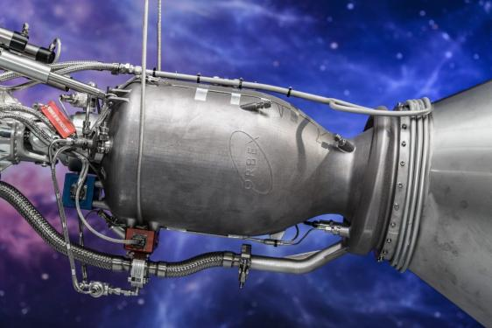
Case Studies of AM
The engine for Orbex Prime has been 3D printed by SLM Solutions on an SLM 800 large format additive manufacturing system
it is made in a single piece, eradicating joins and strengthening the part’s overall integrity
It is made from nickel alloy, and its additive production has saved Orbex 90% in turnaround time and over 50% in costs compared to traditional CNC machining.
The engine reportedly helps make the Prime “30% lighter and 20% more efficient than any other launch vehicle in its category

Slide 24
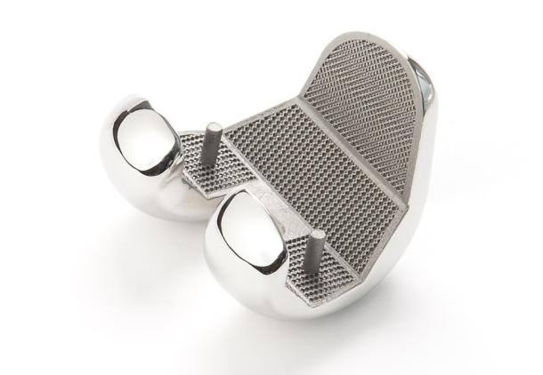
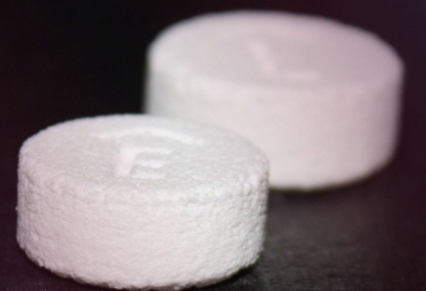

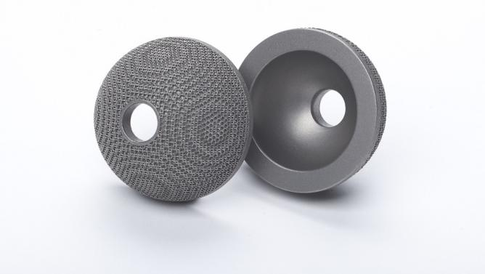
Biomedical and Pharmaceutical Industry
3D Printing of personalized
medicine
Producing controlled
release tablets

Slide 25
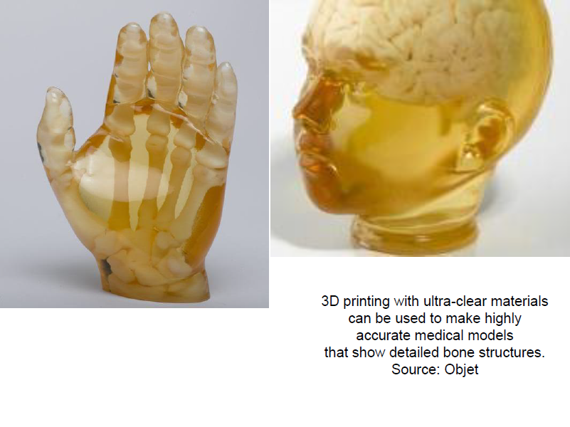
Medical Prototypes

Slide 26

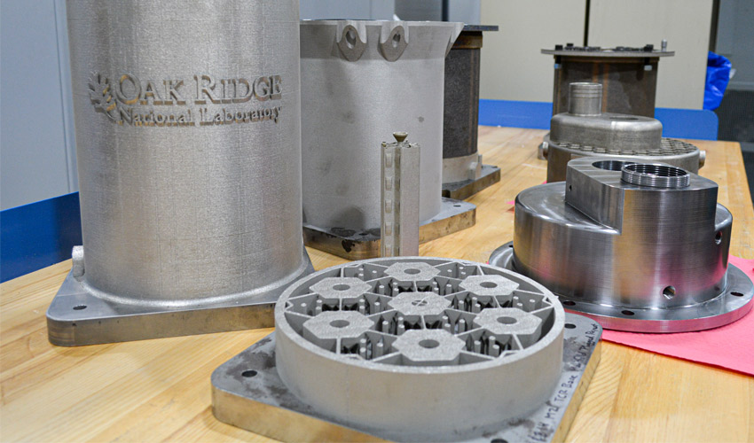
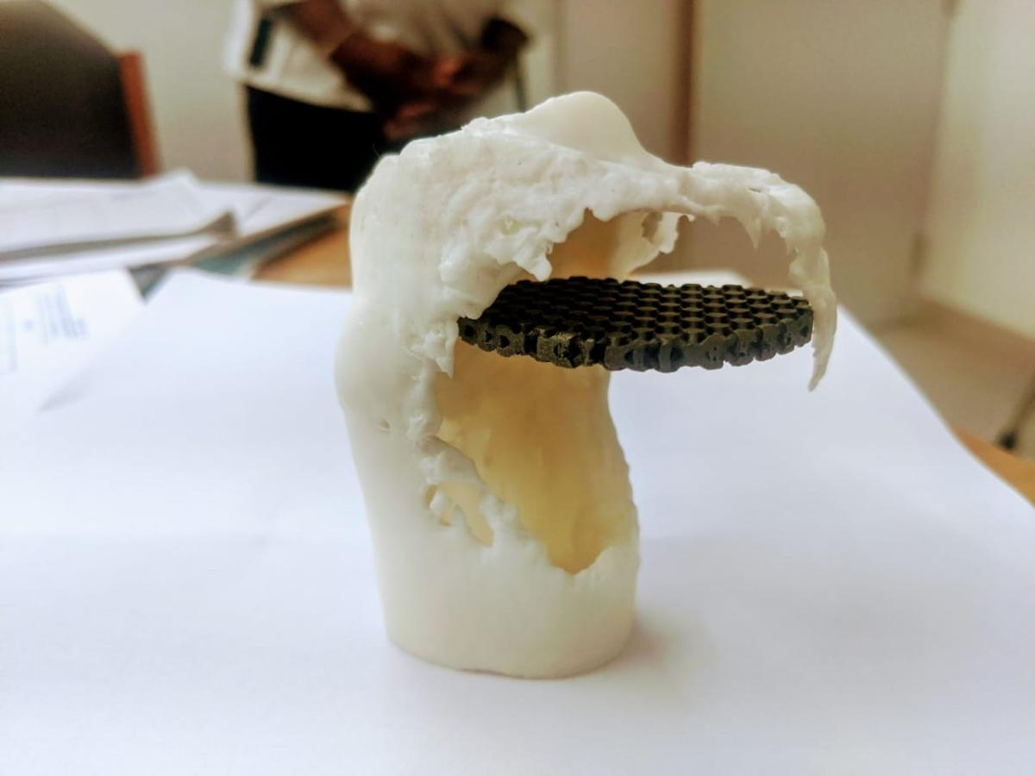
Trending Applications of AM
3D Printed Titanium Implant to Bengaluru Hospital for operating on a Teenage Girl
The 15-Minute 3D Printed Face Mask that went ‘Viral’
ORNL designs first 3D printed nuclear reactor
Credit link: https://manufactur3dmag.com/the-15-minute-3d-printed-face-mask-that-went-viral/
Credit link: https://www.3dnatives.com/reacteur-nucleaire-imprime-en-3d-25052020/
Credit link: https://manufactur3dmag.com/supercraft3d-delivers-3d-printed-titanium-implant-to-bengaluru-hospital-for-operating-on-a-teenage-girl/

Slide 27
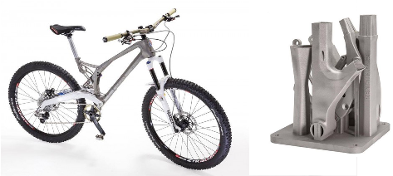
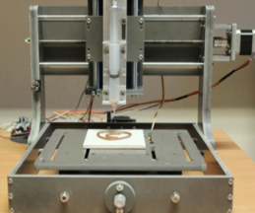
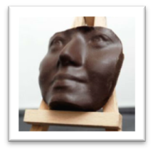
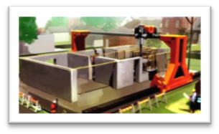
Advancing Applications of AM
The assembly can be personalised and printed in one process.
Food 3D printer
Concrete Printer

Slide 28
Thank You

